Slide 1


Predict the use of shared bicycles
商家煜
郑铠奇
Deep Learning Foundation

Slide 2

Outline
1
Introduction
2
Theory of BPNN
3
Demo of the project
4
Optimization

Slide 3
Contents
1
Introduction
2
Theory of BPNN
3
Demo of the project
4
Optimization

Slide 4
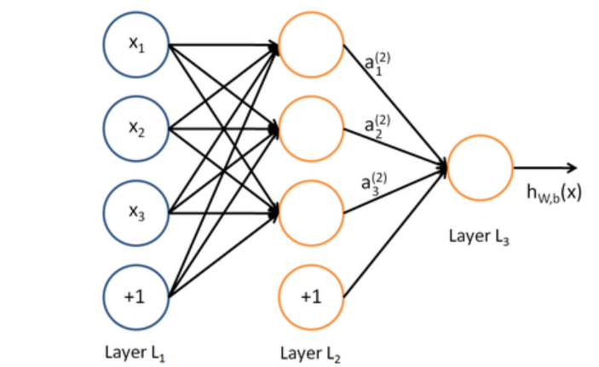
1. Introduction
Back Propagation Neural Network
Computing systems inspired by the biological neural networks that constitute animal brains
Fig.1 Figure of Three-layer Neural Network

Slide 5
1. Introduction
Convolutional Neural Network (CNN)
Fig.3 Convolutional neural network
Sensitive with image

Slide 6
1. Introduction
Recurrent Neural Network(RNN)
Fig.2 Recurrent Neural Network
Sensitive with sequential data

Slide 7
Contents
1
Introduction
2
Theory of BPNN
3
Experimental Result
4
Optimization

Slide 8
2. Theory of BPNN
Back propagation neural network
实验要求：三层神经网络（输入层，隐藏层，输出层）

Slide 9
2. Theory of BPNN
Back propagation neural network
Forward pass
backward pass

Slide 10
2. Theory of BPNN
Forward pass

Slide 11
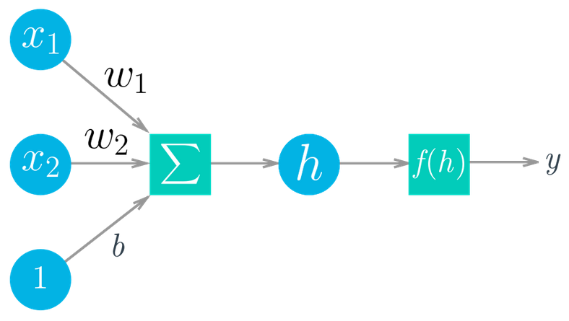
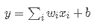
2. Theory of BPNN
Forward pass
Fig.3 神经网络示意图
在这个架构中f(h)称为激活函数，这个函数可以为很多不同的函数，例如如果让f(h) = h。则网络的输出为：

Slide 12
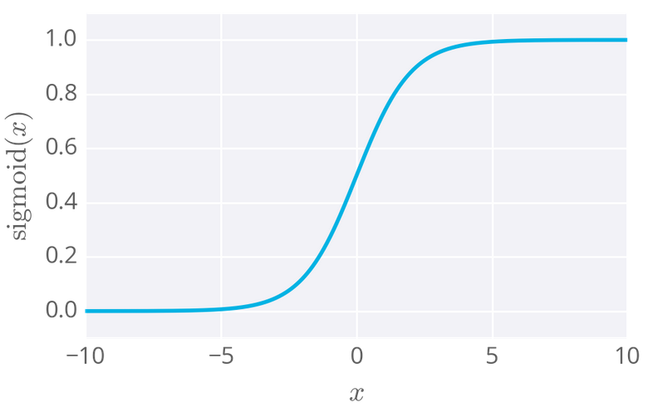
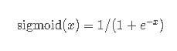
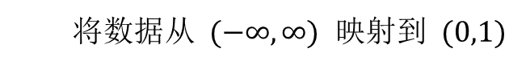
2. Theory of BPNN
Forward pass
将数据从 $(−∞,∞)$ 映射到 $(0,1)$
Fig.3 sigmoid函数
公式：

Slide 13
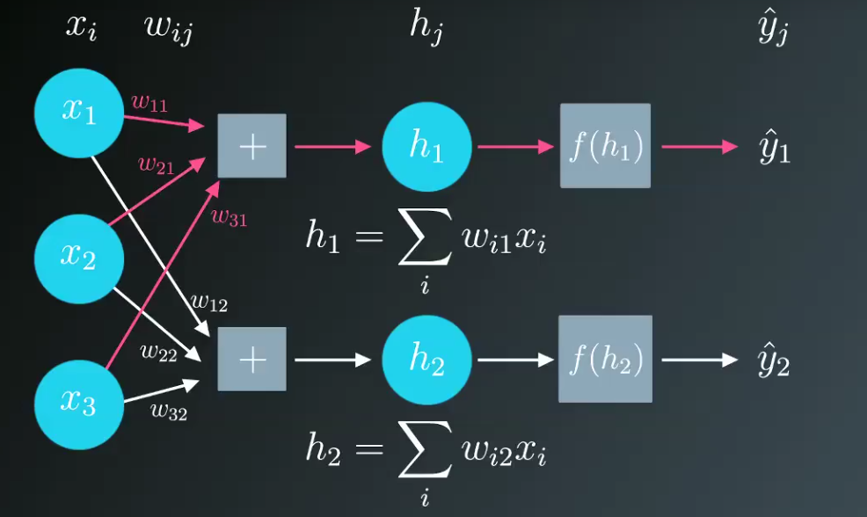
2. Theory of BPNN
Forward pass

Slide 14
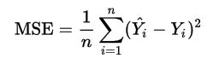
2. Theory of BPNN
Forward pass
Loss function

Slide 15
2. Theory of BPNN
Backward pass

Slide 16
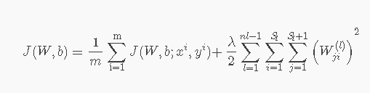
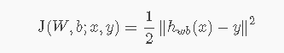
2. Theory of BPNN
Backward pass
Loss function：
其中：

Slide 17
2. Theory of BPNN
Backward pass

Slide 18
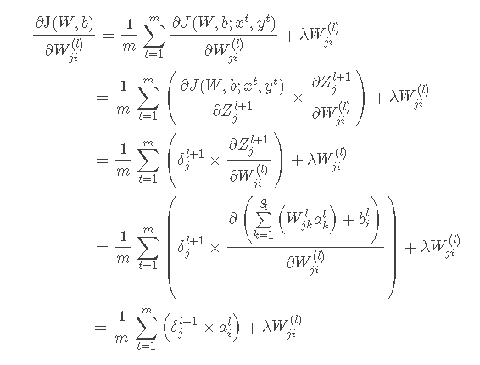
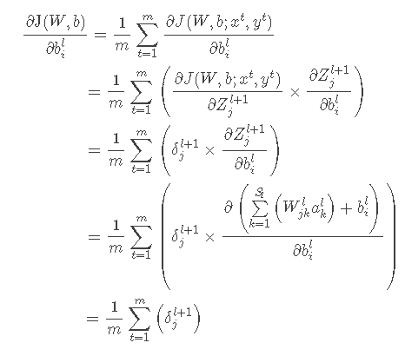
2. Theory of BPNN
Backward pass

Slide 19
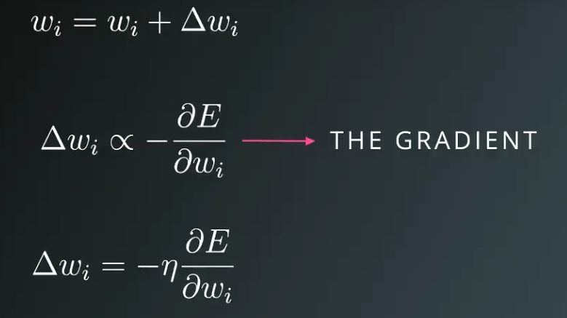
2. Theory of BPNN
Backward pass

Slide 20
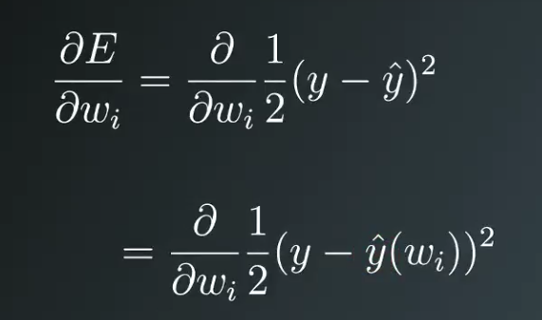
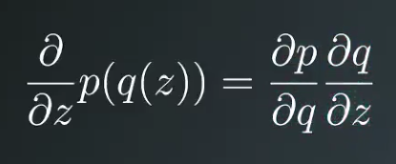
2. Theory of BPNN
Backward pass
通过链式求导

Slide 21
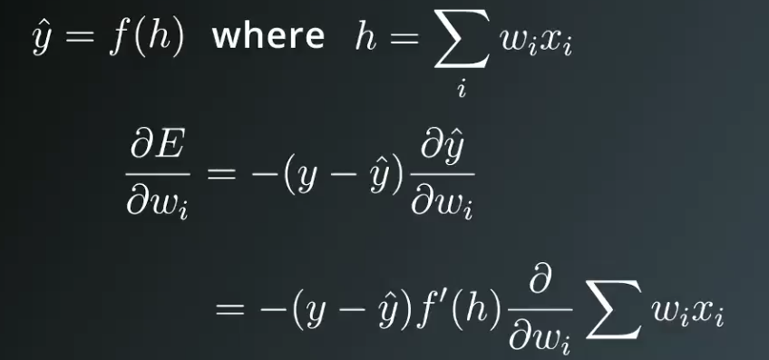
2. Theory of BPNN
Backward pass

Slide 22
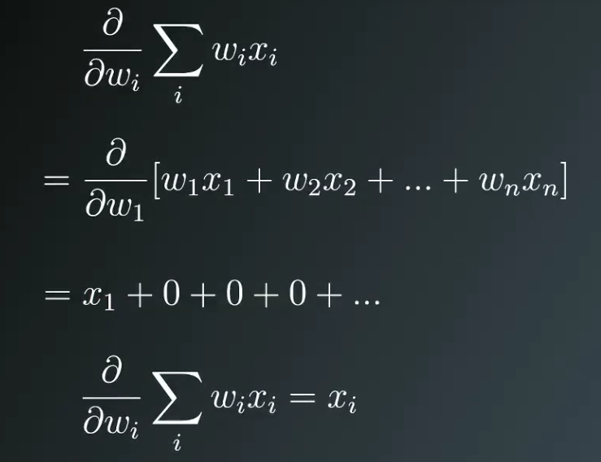
2. Theory of BPNN
Backward pass

Slide 23
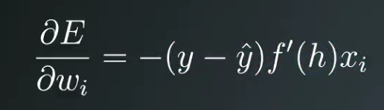
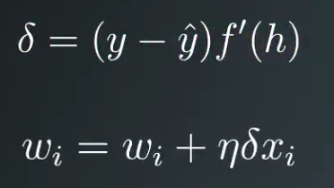
2. Theory of BPNN
Backward pass

Slide 24
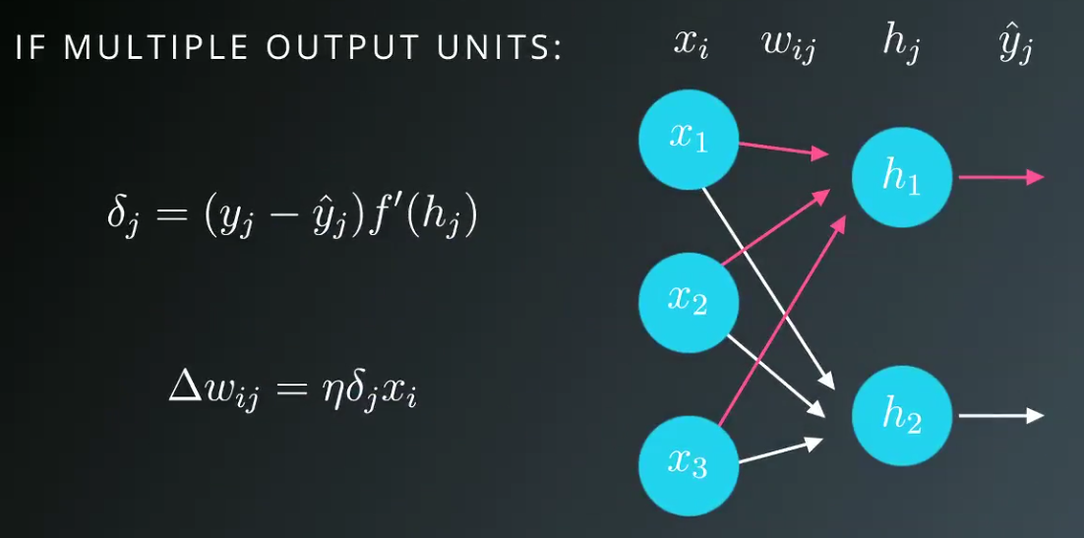
2. Theory of BPNN
Backward pass

Slide 25
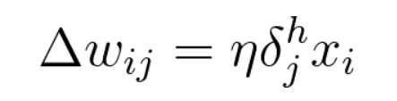
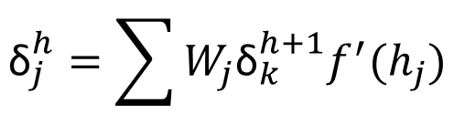

2. Theory of BPNN
Backward pass
h+1层的误差为${\text{δ}}_{k}^{h+1}$， h层节点 j 的误差即为h+1层误差乘以两层间的权重矩阵
$${\text{δ}}_{j}^{h}=\sum{W_{j}{\text{δ}}_{k}^{h+1}f^{′}(h_{j})}$$
梯度下降与之前相同，只是用当前层的误差

Slide 26
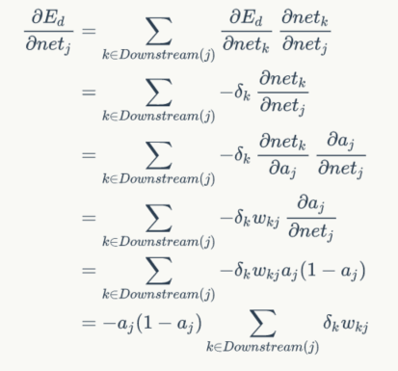
2. Theory of BPNN
Backward pass
当f（x） = sigmoid（x）时：

Slide 27
2. Theory of BPNN
Backward pass

Slide 28
Contents
1
Introduction
2
Theory of BPNN
3
Dataset of the project
4
Optimization

Slide 29
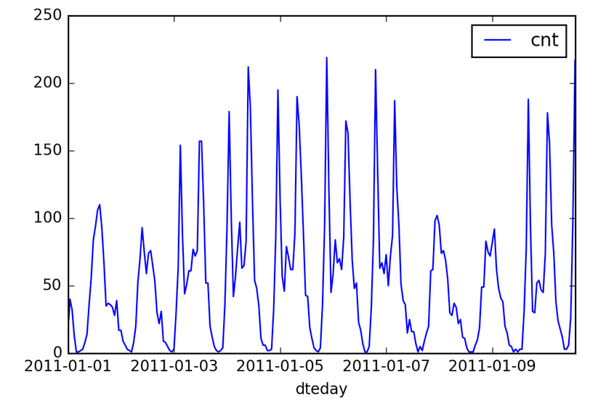
3. Dataset of the project
Background of the project
In this project, you'll build your first neural network and use it to predict daily bike rental ridership.
Fig. 4 Subset of the data

Slide 30
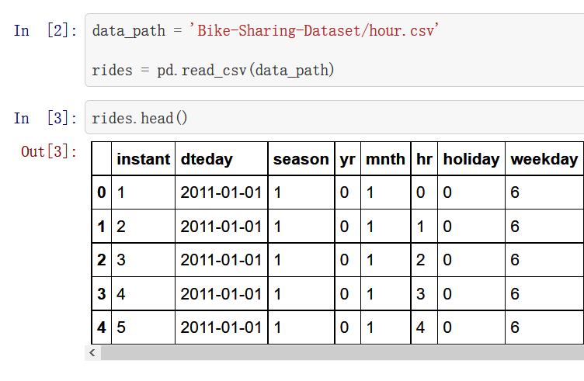
3. Dataset of the project
Load and prepare the data
Fig. 8 show the dataset

Slide 31
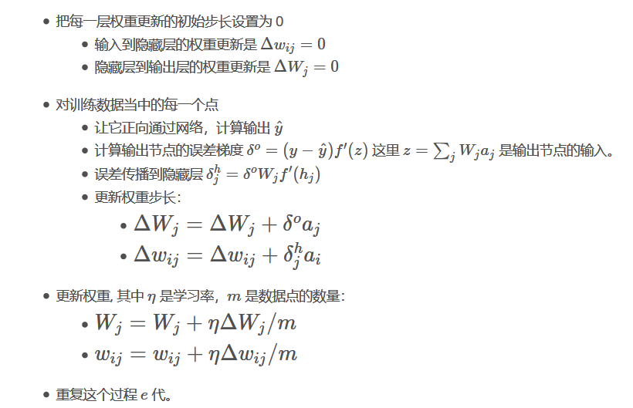
3. Dataset of the project
Build the Network
TODO list:

Slide 32
3. Dataset of the project
Training and Validating
Forward pass
backward pass

Slide 33
Contents
1
Introduction
2
Theory of BPNN
3
Experimental Result
4
Optimization

Slide 34
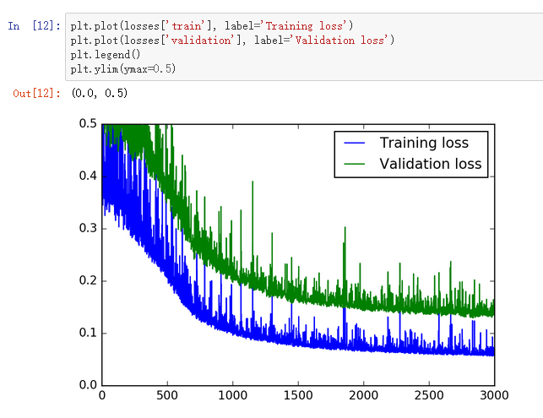
4. Optimization
Training and Validating

Slide 35
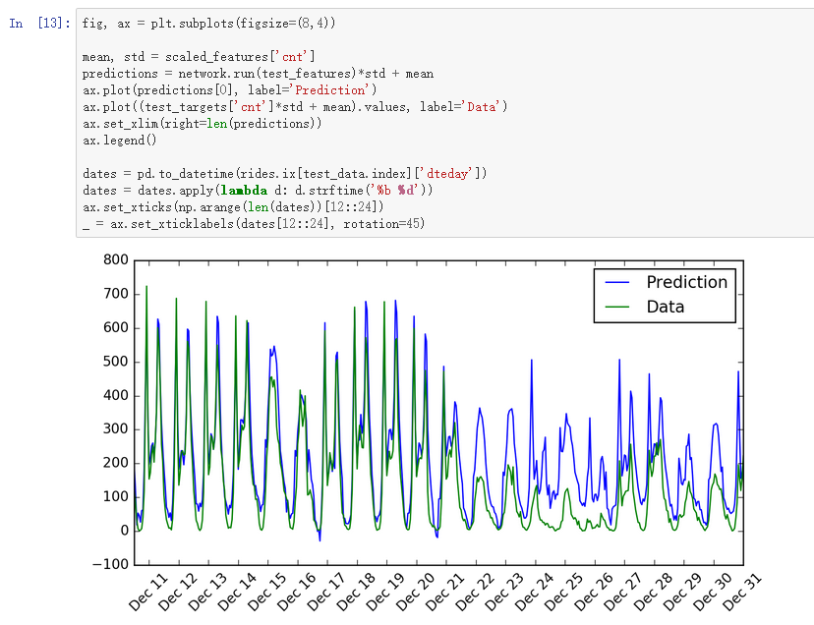
4. Optimization
Training and Validating

Slide 36
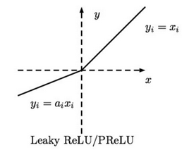
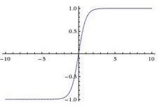
4. Optimization
L2正则化
不同的激活函数
Tanh
Relu

Slide 37
4. Optimization
数据预处理
多层深度神经网络
不同神经网络架构
Mini-batch

Slide 38
任务布置
必须实现三层神经网络（输入层，隐藏层，输出层）
必须在给出的优化建议中任意选择一项实现
自己划分验证集（报告里说明是怎么分的）调整参数
在测试集上预测，提交预测结果

Slide 39
思考题
尝试说明下其他激活函数的优缺点。
有什么方法可以实现传递过程中不激活所有节点？
梯度消失和梯度爆炸是什么？可以怎么解决？

Slide 40
注意事项
实验报告截止日期：
2017.12.06 晚 23:59:59 前提交至 FTP 文件夹
提交文件：
测试集结果：15******_wangxiaoming.txt 每一行对应的是测试样例的标签。
实验报告：15******_wangxiaoming.pdf
代码：15******_wangxiaoming.zip 如果代码分成多个文件，最好写份readme

Slide 41

THANKS

